Slide 1
Abstract
Combining the power of Azure Search with Cognitive Services artificial intelligence algorithms, we can create a search engine that uses language and image analysis to recognize the arguments of a document, the entities, the people, the places in a photo and much more. In this session we will show how to implement such a system and how to leverage it in our applications.

Slide 2
Intelligent searches with Azure Cognitive Search
Marco Minerva
Microsoft MVP Windows Development
Riccardo Cappello
Microsoft MVP Microsoft Azure

Slide 4
Azure AI
AI apps & agents
Machine learning
Knowledge mining
Azure Bot Service
Azure Cognitive Services
Azure Databricks
Azure Machine Learning
Azure AI infrastructure
Azure Cognitive Search

Slide 5

Knowledge Mining is the process of discovering actionable information from large sets of unstructured data, like text or images. It uses Artificial Intelligence to detect hidden patterns and information. It can be used to guarantee compliance, enrich search, automate processes, among other business processes.
Notes:
Elevator Pitch

Slide 6
Cognitive Search is the Microsoft solution for Knowledge Mining. AI approach for content understanding. Ingests unstructured content to create rich metadata into an Azure Search index, with the power of Cognitive Services.
Notes:
At the end of the day…

Slide 7
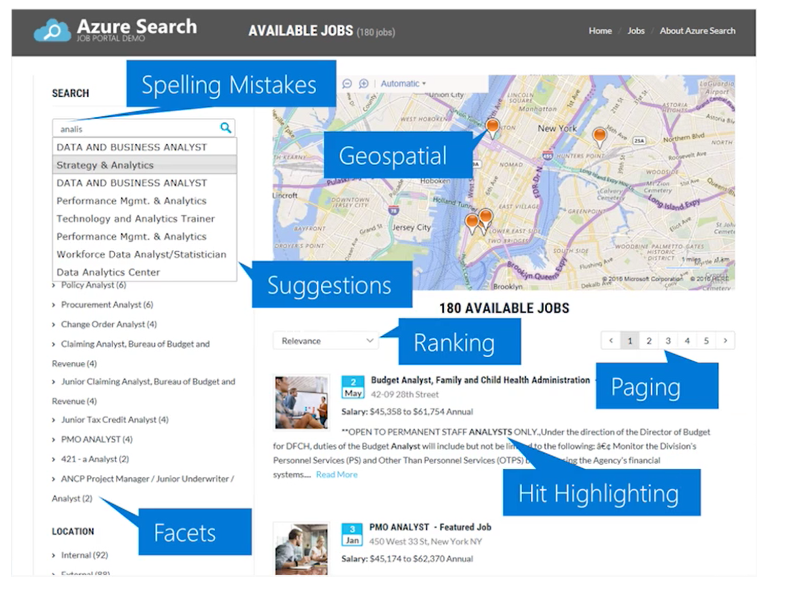
What Azure Search is
AI-Powered cloud search service for web and mobile app development
Enterprise Search as a Service – Azure PaaS product
Enrich and extract insights through cognitive skills (Cognitive Search)
Easily scale up and down
Natural Language Processing for web search grade experience
Connect search results to business goals with great control over search ranking
99.9% SLA, GDPR, Standard Azure OST (Online Service Terms)
Creates indexed metadata about your data

Slide 8
What Cognitive Search is
Azure Search feature, Announced in May 2018 (MS Build)
It uses AI to create searchable metadata, transforming unstructured data into information
Data Enrichment =! Data Integration. Original data isn’t moved, changed or copied
Results are always loaded into an Azure Search Index
10+ regions, including South Central US, West Europe, North Europe, Brazil South, and Southeast Asia
Azure Search Cost + Cost per image + Cost per Cognitive Service used
OR Azure Search Cost + Free up to 20 documents per day

Slide 9






Azure Cognitive Search Pipeline
Data
Source
Enriched
Documents
Ingest Enrich Explore
Any Data format
Any Azure Store
Cognitive Skills
Azure Search API
Portal
Notes:
Azure Search feature, Announced in May 2018 (MS Build)
It uses AI to create searchable metadata, transforming unstructured data into information
Data Enrichment =! Data Integration. Original data isn’t moved, changed or copied
Results are always loaded into an Azure Search Index
10+ regions, including South Central US, West Europe, North Europe, Brazil South, and Southeast Asia
Azure Search Cost + Cost per image + Cost per Cognitive Service used
OR Azure Search Cost + Free up to 20 documents per day
Document cracking: The process of extracting or creating text content from non-text sources during indexing. Optical character recognition (OCR) is an example, but generally it refers to core indexer functionality as the indexer extracts content from application files. The data source providing source file location, and the indexer definition providing field mappings, are both key factors in document cracking.

Slide 10
Demo

Slide 11
References
http://aka.ms/LearnAI-kmb
http://aka.ms/LearnAI-links
https://github.com/DotNetToscana/CognitiveSearch
https://docs.microsoft.com/azure/search/cognitive-search-concept-intro
https://docs.microsoft.com/azure/search/cognitive-search-quickstart-blob
https://docs.microsoft.com/azure/search/cognitive-search-create-custom-skill-example

